Slide 1


1095-B Updates
5/31/2022

Slide 2
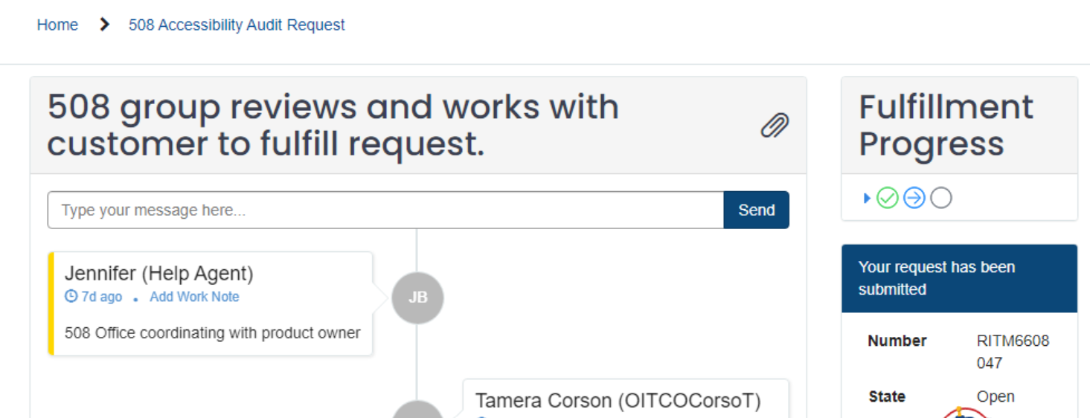
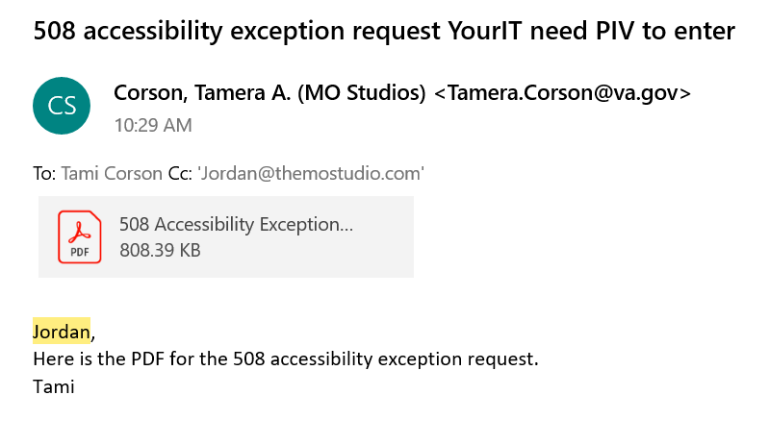
VA 508 Office
5/31/2022
Z# 39722, 38387

Slide 3
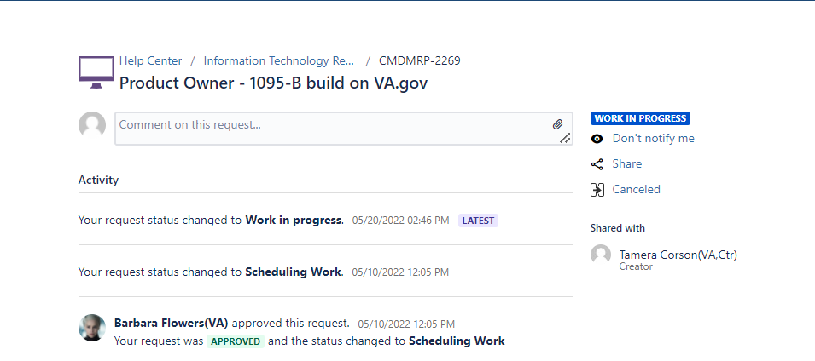
VA Profile (opt-in)
5/31/2022
Z# 39723

Slide 4
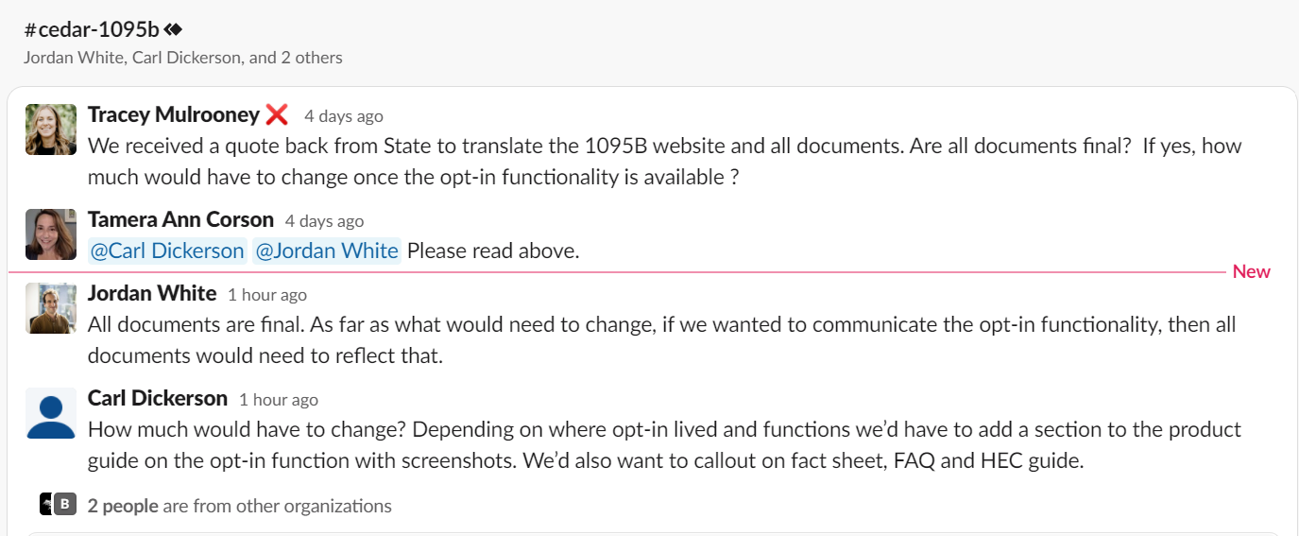
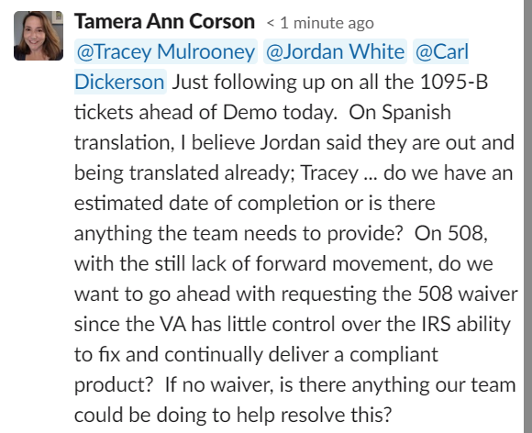
Spanish Translation for HEC
5/31/2022
Z# 40454

